Slide 1
Microsoft Power Platform + Dynamics 365
Notes:
Hi, Welcome to Microsoft Power Platform + Dynamics 365 Bootcamp.

Slide 2
Course Overview
Day 1
Empowering Everyone with Power Platform – From CEO to Frontline Workers
Introduction to Power Platform
Day 2
Power Packed Day with Power Canvas Apps
Introduction to PowerApps
Day 3
Power Packed Day with Power Model Driven Apps
Let’s talk about data
Day 4
Power Packed Day with Power Automate
Introduction
Day 5
Power Packed Day with Power Virtual Agents
Introduction
Microsoft Power Platform momentum
Why Power Platform?
Customer Stories
Demo
Benefits of PowerApps
What can I build with PowerApps?
Types of PowerApps
Canvas Apps
Data Sources and Connectors
Demo
Types of flow
Data types and expression
Working with Arrays
Control flow and action settings
Demo
Types of Data
Common Data Service
Model-driven Apps
What type of components can I add?
Data model design
Demo
A Robust Virtual Agent Platform
Converse everywhere
Easily make your bots better
Create personalized customer experiences
Transfer to a human agent
Built on Power Platform & Azure Bot Service
Extend your bot capabilities with Azure Bot Service
Demo

Slide 3
Continue…
Day 6
Power Packed Day with Power BI
Introduction
Day 7
Power up your Apps with AI Builder
Introduction
Day 8
Power Platform Administration, Security & Integration Connectors
Introduction
Day 9
Power Packed Bizz Apps Day – Sales & Marketing
Introduction
Day 10
Power Packed Bizz Apps Day– Finance & Supply Chain
Introduction
AI for every app. And everyone
Setup Environment
Types of AI Model
Prediction
Form processing
Object detection
Text classification
Demo
The 5x5 Principle
Customer momentum: Power BI
Power BI Desktop
Data sources
Power Query
Dataflow
Using a Calculation (DAX) in multiple files
Paginated Reporting
Power BI Admin Portal
Demo
Secure your tenant
Monitor your tenant’s activity
Alert & act on that activity
Connectors
SharePoint Integration
Demo
Nurture more demand
Personalize buyer experiences
Build relationships at scale
Make insight-driven decisions
Demo
How to embed PowerApps in Dynamics 365 for Sales and Marketing
Technology Modernization
Modern Finance
Supporting modern supply chain management
Demo
How to embed Power Platform in Dynamics 365 for Finance and Supply Chain

Slide 4
Day 8: Power Platform Administration, Security & Integration Connectors

Slide 5

Agenda
Introduction
Secure your tenant
Monitor your tenant’s activity
Alert & act on that activity
Connectors
SharePoint Integration
Demo
Environment controls and data loss prevention policies
Build and deploy custom Connector
Build a Canvas App using SharePoint data sources

Slide 6
Securing your tenant

Slide 7
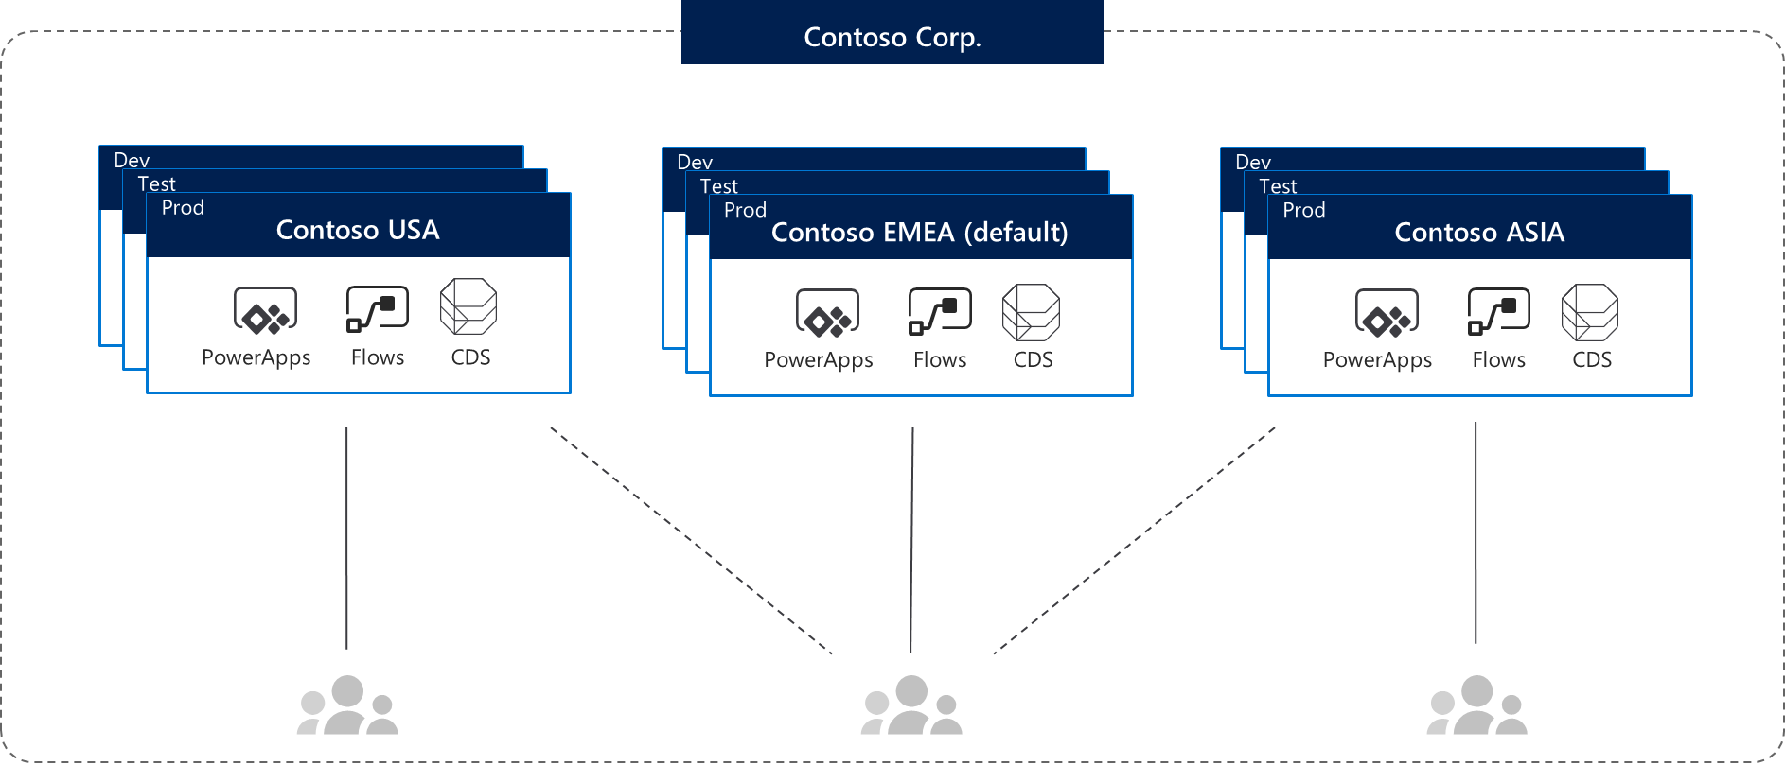
Environments
Environments are containers that administrators can use to manage apps, flows, connections, and other assets; along with permissions to allow organization users to use the resources

Slide 8
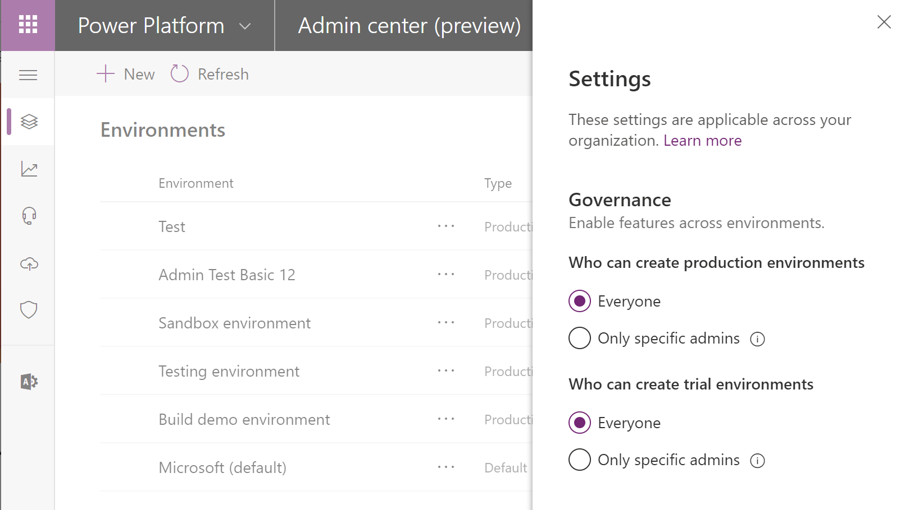
Environment key facts
Environments are tied to a geographic location that is configured at the time the environment is created
Environments can be used to target different audiences and/or for different purposes such as dev, test and production
Every tenant has a Default environment where all licensed PowerApps and Flow users can create apps & flows
Non-default environments offer more control around permissions
Non-default environment creation can be restricted to only global and service admins from the Power Platform admin center: https://aka.ms/ppac

Slide 9
Establish an environment strategy
Assign your admins the Power Platform service admin role, which grants full access to PowerApps, Flow, & PowerBI
Restrict the creation of net-new trial and production environments to admins
Treat the default environment as a ‘Personal productivity’ environment for your business groups (renaming the environment is recommended)
Establish a process for requesting access or creation of environments
Dev/Test/Production environments for specific business groups or applications
Individual-use environments for POCs and trainings

Slide 10
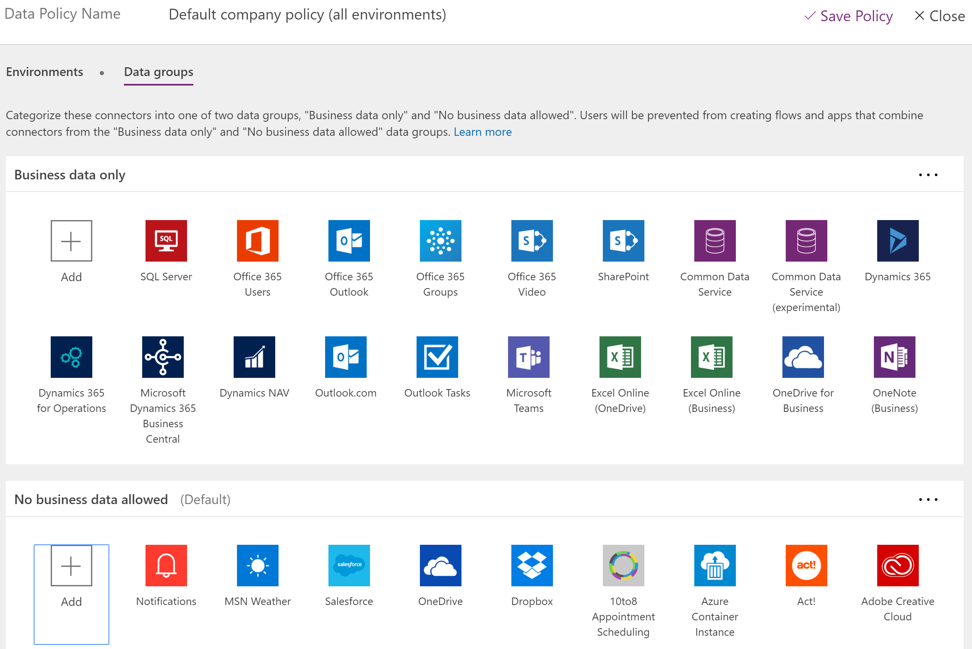
Data loss prevention key facts
Data loss prevention policies (DLP) enforce rules for which connectors can be used together
Connectors are classified as either Business Data only or No Business Data allowed
A connector in the business data only group can only be used with other connectors from that group in the same app or flow
Tenant admins can define policies that apply to all environments
Non-Microsoft connectors can fully blocked using DLP policies

Slide 11
Setup data loss prevention (DLP) policies
Create a policy spanning all environments that blocks all unsupported non-Microsoft connectors and classifies all Microsoft connectors as ‘Business Data’
#1: Block unsupported non-Microsoft connectors (e.g. Dropbox, social media)
Default
Training #1
Training #2
Dev
Dev
Test
Test
Prod
Prod
Contoso Europe
Contoso USA

Slide 12
Setup data loss prevention (DLP) policies
Create a policy spanning all environments that blocks all unsupported non-Microsoft connectors and classifies all Microsoft connectors as ‘Business Data’
Create a policy for the default environment (and other training environments) that further restricts which Microsoft connectors are classified as ‘Business Data’
#1: Block unsupported non-Microsoft connectors (e.g. Dropbox, social media)
#2: Restrict ‘business data’ connectors (e.g. only Office 365 connectors are business data)
Default
Training #1
Training #2
Dev
Dev
Test
Test
Prod
Prod
Contoso Europe
Contoso USA

Slide 13
Setup data loss prevention (DLP) policies
Create a policy spanning all environments that blocks all unsupported non-Microsoft connectors and classifies all Microsoft connectors as ‘Business Data’
Create a policy for the default environment (and other training environments) that further restricts which Microsoft connectors are classified as ‘Business Data’
Create additional policies or exclude those environment from policies #1 and #2 above that permit certain connectors to be used for specific environments: approved custom connectors
#1: Block unsupported non-Microsoft connectors (e.g. Dropbox, social media)
#2: Restrict ‘business data’ connectors (e.g. only Office 365 connectors are business data)
#3: Create exception policy for certain application environments
Default
Training #1
Training #2
Dev
Dev
Test
Test
Prod
Prod
Contoso Europe
Contoso USA

Slide 14
Monitor your tenant’s activity

Slide 15
Logs & analytics – see what’s happening
1. PowerApps and Flow logs available at https://protection.office.com
The audit records are stored in Office 365 Security and Compliance center.
Must have an Office 365 E3 or greater license
Must enabled at the organization level
Office provides an API to query this data, which is currently used by many SIEM vendors to use the Activity Logging data for reporting
Microsoft Flow | PowerApps
Created flow Edited flow Deleted flow Edited permissions Deleted permissions Started a paid trial Renewed a paid trial | Created app Edited/save app (draft) Published app Deleted app Restored an app from app version Launched app Marking app as featured Marking app as hero Edited app permissions Deleted app permissions

Slide 16
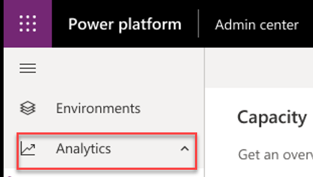
Logs & analytics – see what’s happening
1. PowerApps and Flow logs available at https://protection.office.com
2. Admin analytics available at https://aka.ms/ppac
Tenant and environment level analytics
Available from Power Platform admin center
Access is available for environment admins
Data is stored for 28 days
Data is refreshed daily
Capacity Management
Common Data Service
Microsoft Flow
PowerApps

Slide 17
Alert & act on that activity

Slide 18


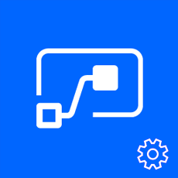

Leverage management connectors & PowerShell as powerful reporting tools + tools for action
The PowerShell Cmdlets give admins full visibility to all activity for PowerApps and Flow in their organization - aka.ms/powerappspowershell.
Management connectors
Full visibility: Power Platform APIs in an accessible connector interface, provide admin access to resources
Customization : Pull the metadata you need to build the custom reports you want
Flexibility: Build the policies you need to implement administration + governance requirements
Power Platform for Admins
PowerApps for Admins
Flow Management
PowerApps for App Makers

Slide 19
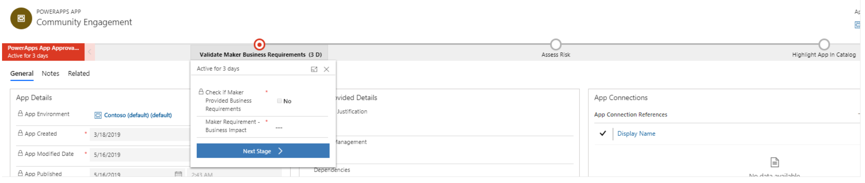
Establish and automate your audit process
Create your own workflows using the management connectors that permit or restrict behavior based on your organization’s policies (e.g. create an attestation process for assets in the default env)
CoE starter kit comes with its own audit workflow template:
Canvas app, flow creation | aka.ms/restrictappcreators
Specific connector usage | aka.ms/restrictflowconnector aka.ms/restrictappconnector
Newly added connectors | aka.ms/newconnectornotification

Slide 20
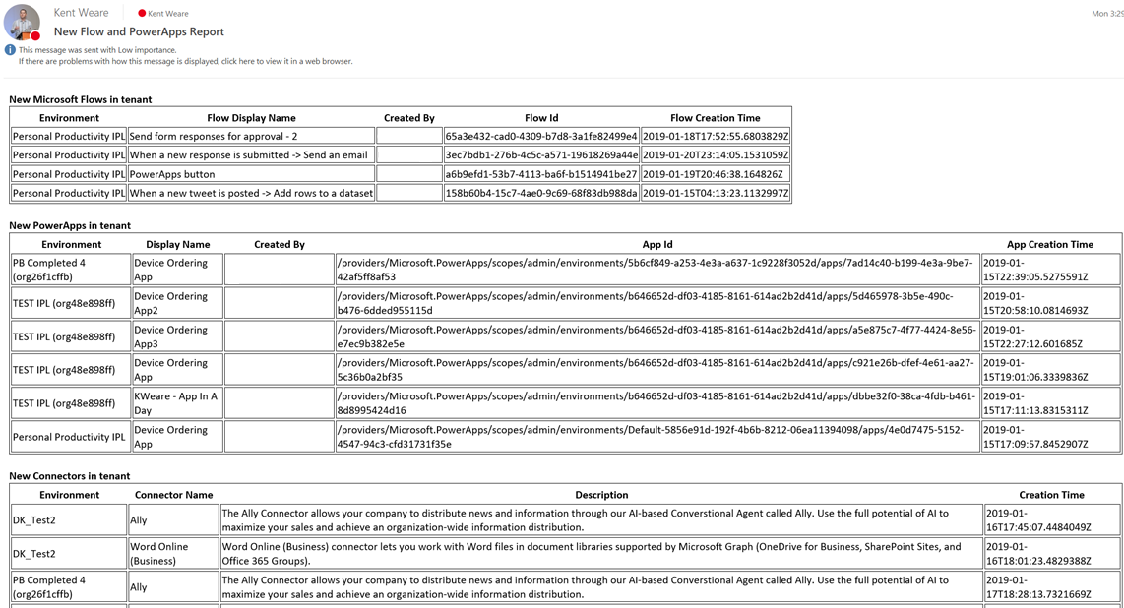
Welcome new makers and identify champions
Welcome new makers
Detect when new flow has been created
Check to see if they are part of makers AAD Group
If new, send welcome email with company and public resources
Invite them to Internal Yammer Club
https://aka.ms/powerwelcomeemail
Identify champions
New Flow, PowerApps and Connectors Digest
Sent Daily
Oversight
Empower new users
https://aka.ms/newmakerdigest

Slide 21
Connectors

Slide 22




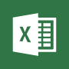











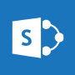






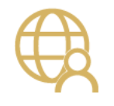




Integrate the systems you’re already using…

Slide 23
Why build a connector?
Enterprise developers
Looking for connectivity to a service we don’t currently support
Need connectivity to a custom or internal service
Partners and ISVs
Expand the number of services you integrate with
Provide the extensibility your customers need
Increase exposure and adoption

Slide 24
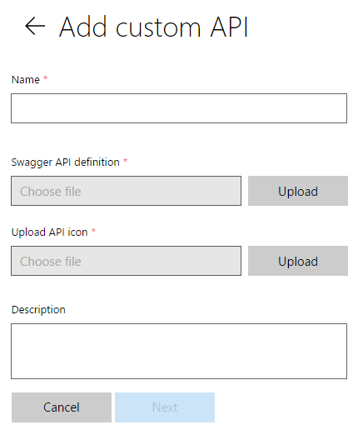
Connecting your services to PowerApps & Flow
PowerApps & Flow are fully metadata-driven and extensible so you can connect to any of your own services
Even connect to 3rd party services you consume
Custom APIs within an organization
Scoped to a company so that you can build something that’s unique to that organization
Leverage Azure functions within your apps & flows
Via custom APIs today, integrated support coming soon

Slide 25
Building a Custom Connector



Develop
Build, secure and describe your API
Import from existing artifacts (Open API, Postman) or build from scratch
Test
Validate your API calls
Use in Flow and PowerApps for E2E testing
Share
Allow other users within your organization to use your connector

Slide 26
Building a Custom Connector




Develop
Build, secure and describe your API
Import from existing artifacts (Open API, Postman) or build from scratch
Test
Validate your API calls
Use in Flow and PowerApps for E2E testing
Share
Allow other users within your organization to use your connector
Certify
Share your connector with all users of Flow and PowerApps
Only for Public Connectors

Slide 27
Custom connector architecture
Hosting environment
Connector ID
+
Operation
+
Connection ID
Host
+
Path
+
Credentials
RESTful API
Microsoft Flow
Custom connector
PowerApps

Slide 28
Using your own Web API
Hosting environment
Your
Web API
Microsoft Flow
Custom Connector
PowerApps

Slide 29
Securing your Web API
Hosting environment
AAD Application #1
AAD Application #2
Your
Web API
Microsoft Flow
Custom Connector
PowerApps

Slide 30
SharePoint Integration

Slide 31


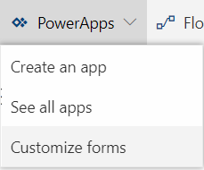


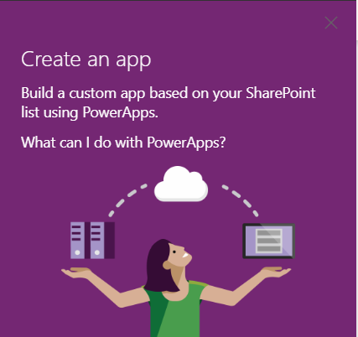

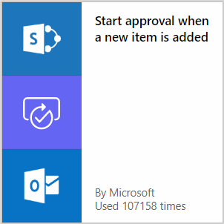

Customize SharePoint forms
SharePoint lists as a data source for PowerApps
Approval workflow in SharePoint (and many more)

Slide 32

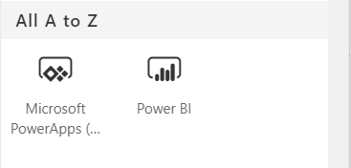


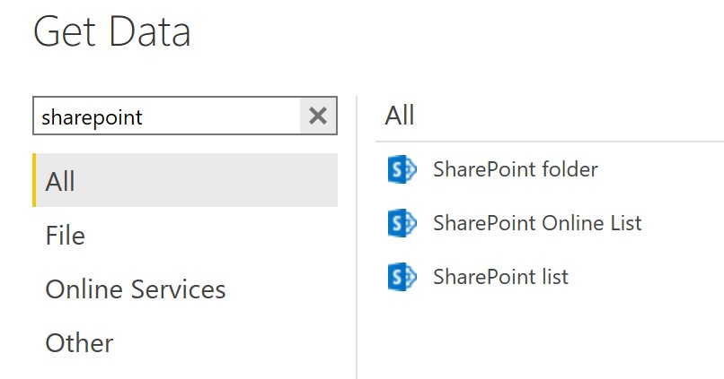

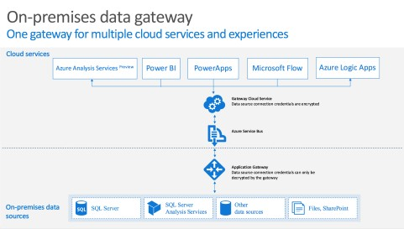

SharePoint webparts
SharePoint as a data source for Power BI
SharePoint on-premises via data gateway
https://docs.microsoft.com/en-us/powerapps/maker/canvas-apps/gateway-reference

Slide 33

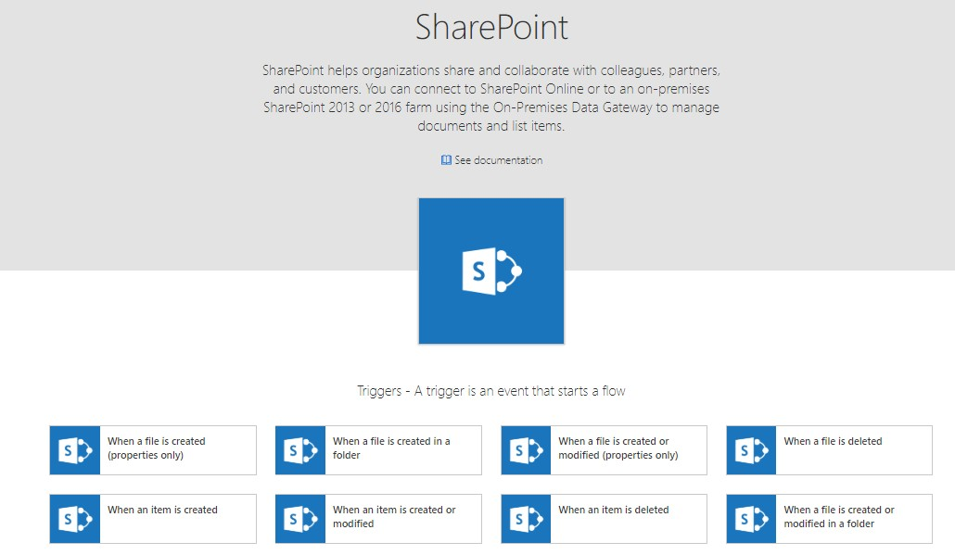

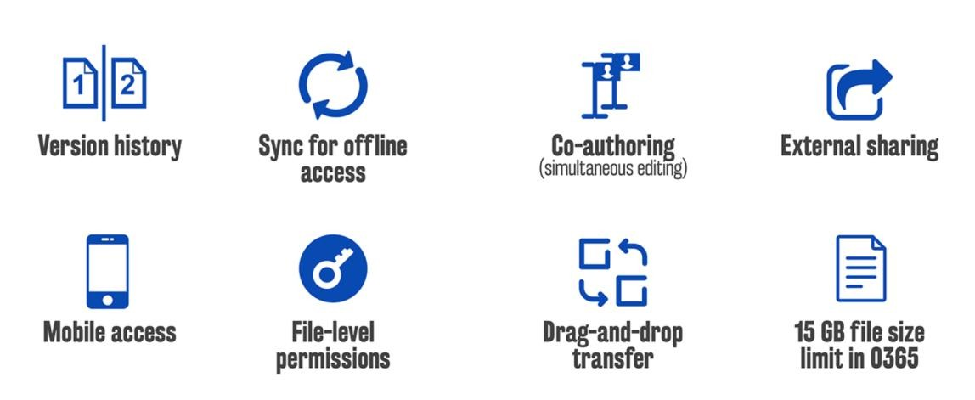
A ubiquitous data storage in Office 365
Key features for SharePoint and OneDrive

Slide 34
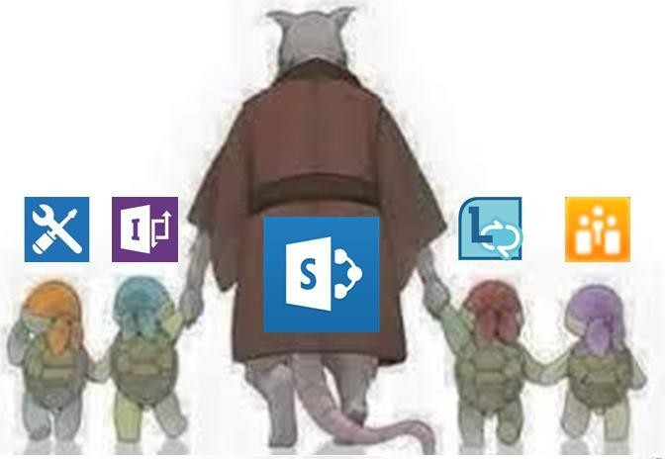
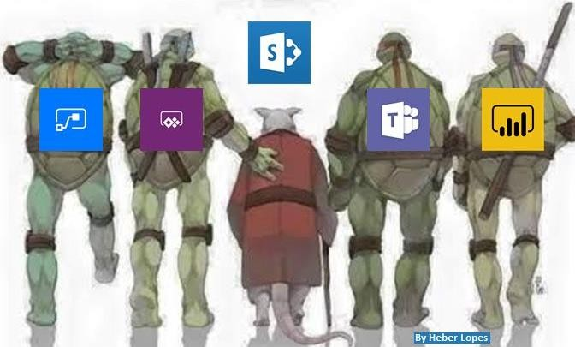
@HeberOLopes

Slide 35

Demo
Environment controls and data loss prevention policies
Build and deploy custom Connector
Build a Canvas App using SharePoint data sources
Notes:
https://docs.microsoft.com/en-us/powerapps/maker/model-driven-apps/model-driven-app-overview
https://docs.microsoft.com/en-us/powerapps/maker/model-driven-apps/build-first-model-driven-app
https://docs.microsoft.com/en-us/powerapps/maker/model-driven-apps/model-driven-app-components

